Slide 1

May 2022

Slide 2
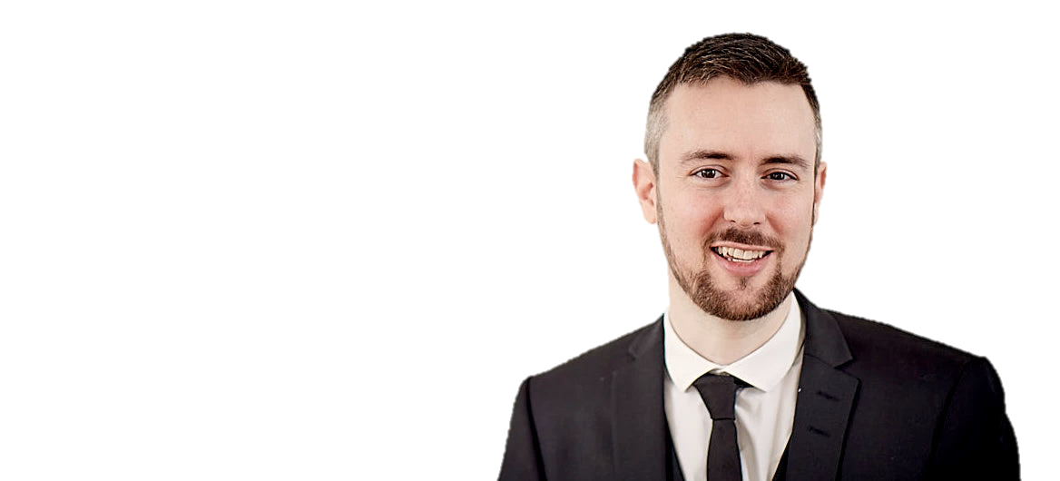
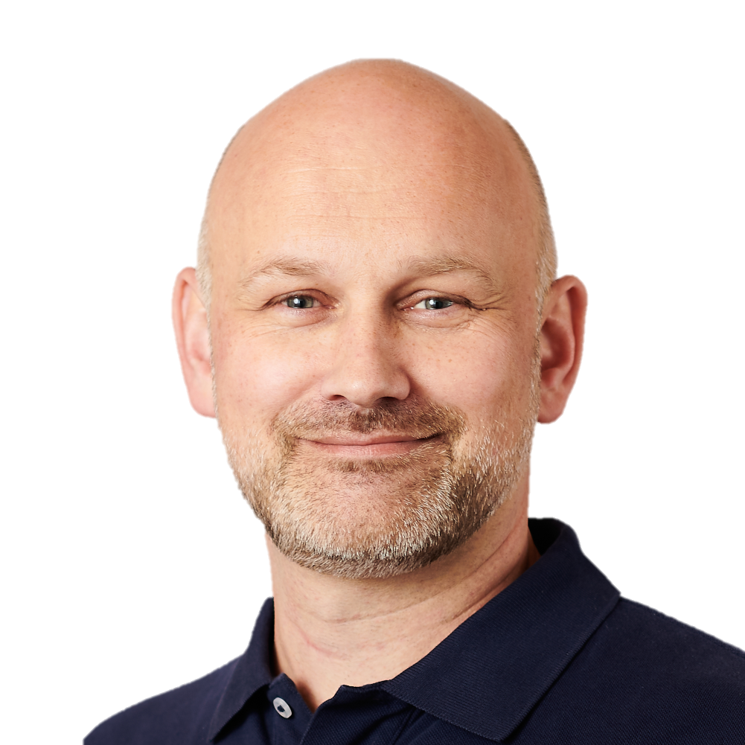
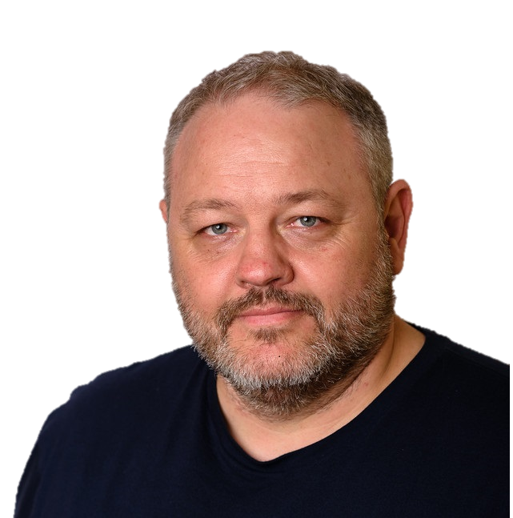

The WP Ninjas Denmark Team
Peter Schmidt
Michael Mardahl
Ronni Pedersen

Slide 3

Main focus for Workplace Ninja’s
Microsoft 365 / Modern Workplace
Windows 365 / Azure Virtual Desktop
Microsoft Azure (supporting Microsoft 365)
Microsoft Security

Slide 4
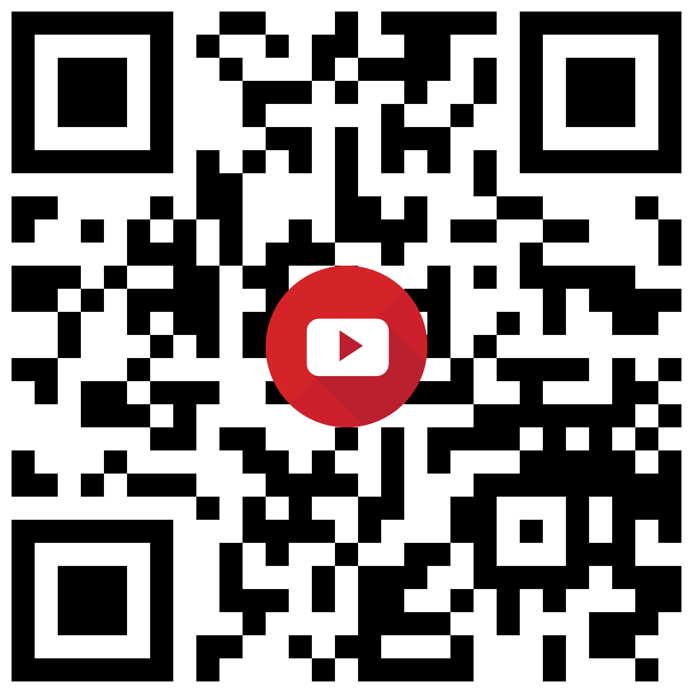

Live Chat on YouTube
YouTube Channel: https://www.youtube.com/c/WorkplaceNinjaUserGroupDenmark/
Chat/Questions: Subscribers only
Min. Subscriber periode: 5 mins.

Slide 5
YouTube
YouTube Channel: https://www.youtube.com/c/WorkplaceNinjaUserGroupDenmark/

Slide 6

LinkedIn Group
Workplace Ninja's Danmark
https://www.linkedin.com/groups/14077454/
Announcements
Event Announcements
Speaker Announcements
Recordings
Invite your peer’s to the group

Slide 7
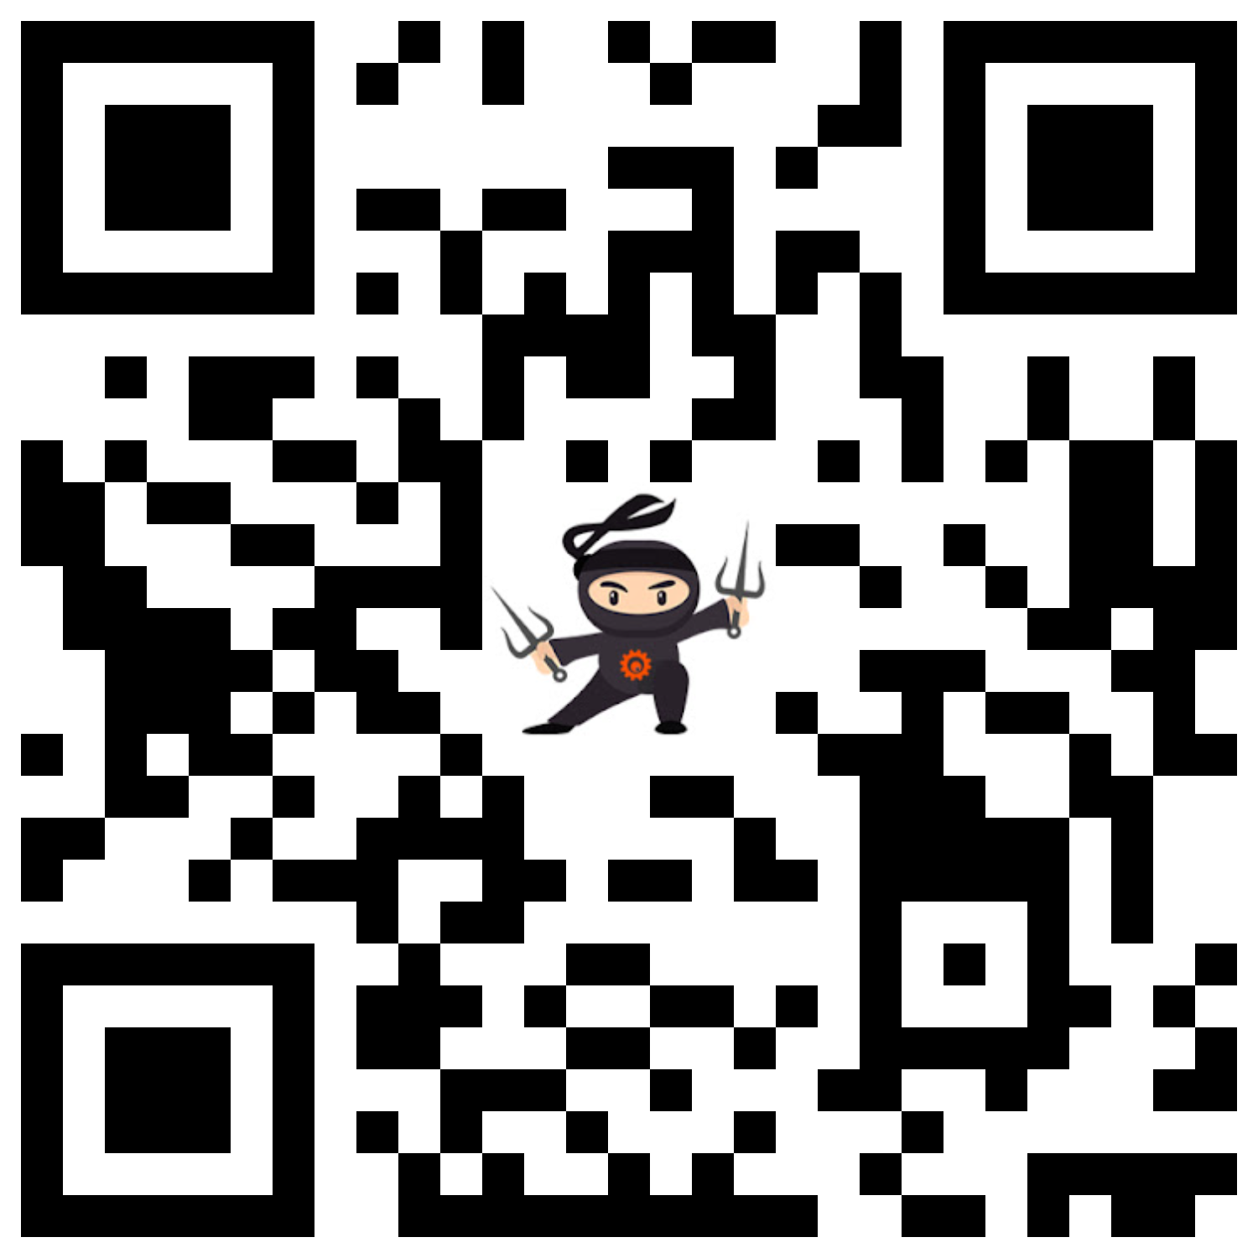
Website
Workplace Ninja's Danmark
https://wpninjas.dk/
General Information
Meetup Calendar
Recordings from previous events
More…

Slide 8
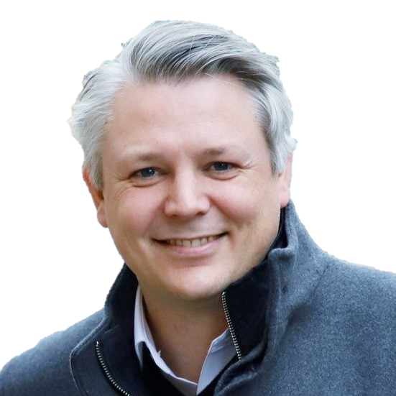
Today’s Agenda
Agenda:
09:00 – 09:05 – Welcome (Michael, Peter & Ronni)
09:05 – 09:55 – Digital Wellbeing: Working smart in Microsoft 365
10:00 – 10:30 – Teams Architecture Deep Dive
10:30 – 10:45 – Windows 11 - How to get there!
10:45 – 11:00 – Expert Panel AMA and Wrap-up

Slide 9

Meetup Schedule
Upcoming Events for 2022:
June 3rd 2022
July 8th 2022
August 12th 2022
September 9th 2022
October 14th 2022
November 11th 2022
December 9th 2022

Slide 10
Lets get started…

